Slide 1
NCA Sponsored Training
Day 1 – Afternoon Session (Theory)
Cryptography 101
Presenter Name: Dr. Danish Vasan
City: Dhahran
15 February 2025
Notes:
Some of the material used in this presentation has been adapted and remixed from course materials from the Virginia Tech University and Purdue University

Slide 2
Outline
Introduction to Cryptography
Goals
Basic Terminology
Approaches
History of Cryptography
Classic Ciphers
Symmetric Encryption
Modern Algorithms

Slide 3

Goals of Cryptography
Problem
Ensure security of communication over an insecure communication channel
Secure Communication
Confidentiality: only the intended recipient can see the communication
Integrity: the communication is generated by the alleged sender
Insecure channel
the adversary can eavesdrop
the adversary has full control over the communications

Slide 4

Approaches to Secure Communication
Steganography
“covered writing”
hides the existence of a message
depends on secrecy of method
Cryptography
“hidden writing”
hide the meaning of a message
depends on secrecy of a short key, not method

Slide 5

Goals
Prevent sensitive data from being read without authorization
Detect any unauthorized tampering of sensitive data
Implement non-repudiation (digital signatures)

Slide 6
Basic Terminology
Plaintext: original message
Ciphertext: coded message
Cipher: algorithm for transforming plaintext to ciphertext
Key: info used in cipher known only to sender/receiver

Slide 7
Basic Terminology
Encipher (encrypt): converting plaintext to ciphertext
Decipher (decrypt): recovering plaintext from ciphertext
Cryptography: study of encryption principles/methods
Cryptanalysis (codebreaking): study of principles/methods of deciphering ciphertext without knowing the key
Cryptology: field of both cryptography and cryptanalysis

Slide 8
History of Cryptography
2500+ years
An ongoing battle between codemakers and codebreakers
Driven by communication & computation technology
paper and ink
cryptographic engine & telegram, radio
modern cryptography: computers & digital communication

Slide 9
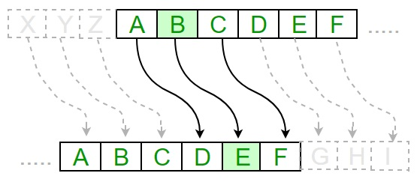
Classical Substitution Ciphers
Letters of plaintext are replaced by other letters or by numbers or symbols
OR
if plaintext is viewed as a sequence of bits, then substitution involves replacing plaintext bit patterns with ciphertext bit patterns

Slide 10
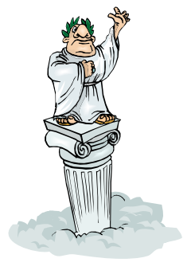
Shift Cipher
Also knows as Caesar Cipher
Shift (Rotate) letter by agreed-upon number
Recipient shifts back by the same number of letters
Used for hundreds of years after Caesar’s time!
A B C D E F G H I J K L M N O P Q R S T U V W X Y Z
SAUDI = RZTCH
Z A B C D E F G H I J K L M N O P Q R S T U V W X Y

Slide 11
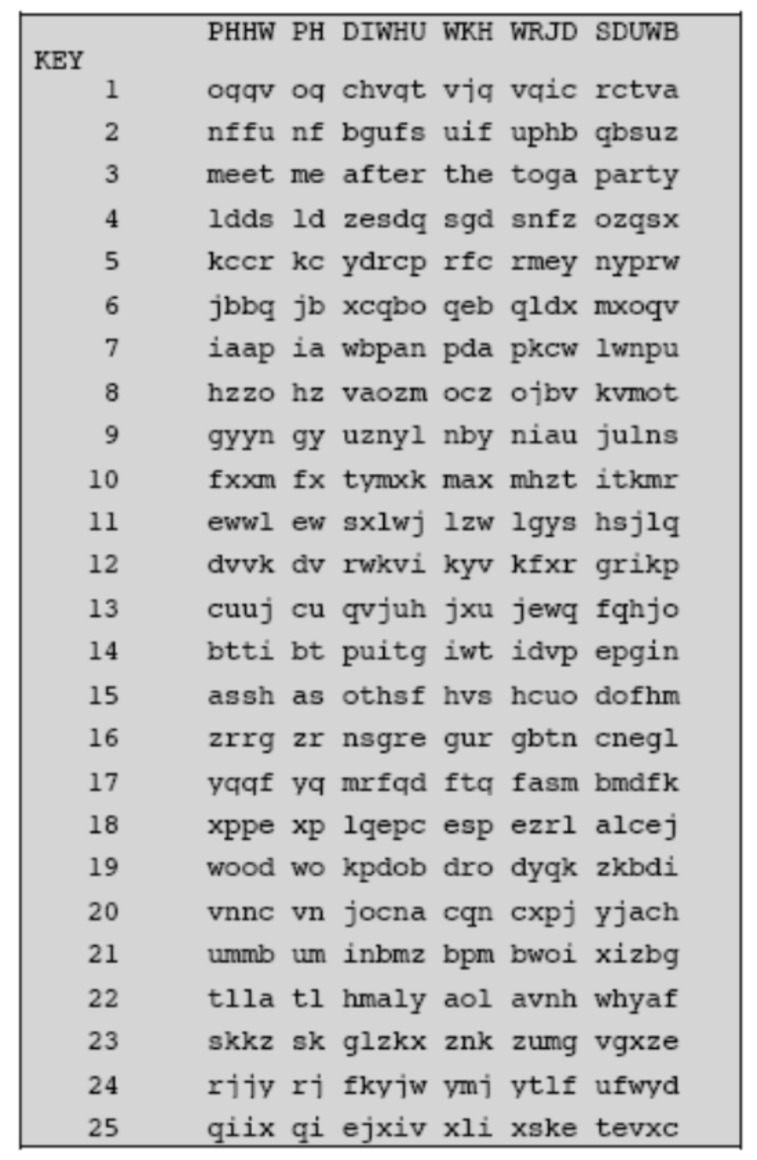
Shift Cipher - Cryptanalysis
Can an attacker find K?
Only 25 possible ciphers (A maps to B, C, ... Z)
Could simply try each in turn
Given a ciphertext, just try all shifts of letters

Slide 12
Mono-alphabetic Cipher
Rather than just shifting the alphabet, could shuffle the letters arbitrarily
Each plaintext letter maps to a different random ciphertext letter
The key space: all permutations of The key space: all permutations of ∑ = {A, B, C, …, Z}
A B C D E F G H I J K L M N O P Q R S T U V W X Y Z
SAUDI = LBJCG
B A D C Z H W Y G O Q X S V T R N M L K J I P F E U

Slide 13
Mono-alphabetic Cipher - Cryptanalysis
Can an attacker find K?
Exhaustive search is difficult (key space size is 26! ~ 4x10²⁶)
Dominates the art of secret writing throughout the first millennium A.D.
Thought to be unbreakable by many back then

Slide 14
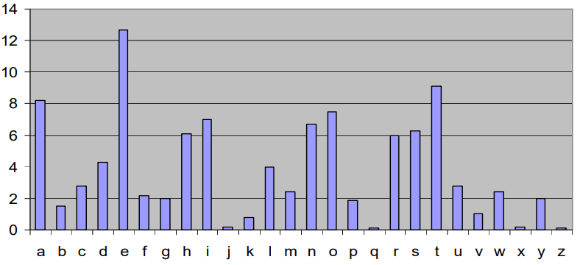
Substitution Ciphers - Cryptanalysis
Frequency of Letters in English

Slide 15
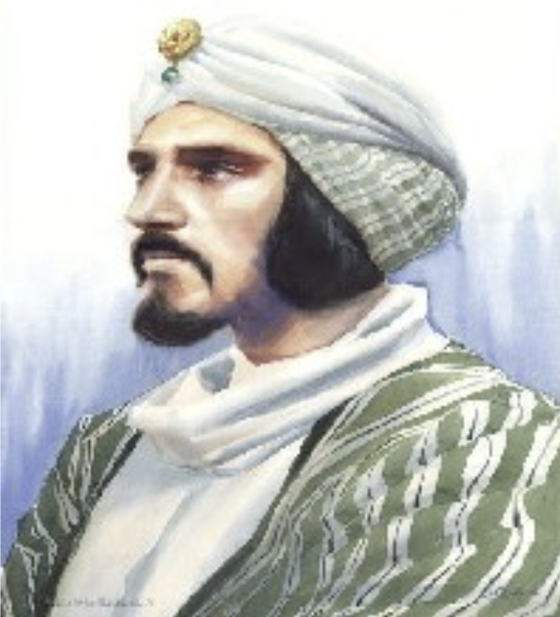
Substitution Ciphers - Cryptanalysis
Frequency Analysis
Each language has certain features: frequency of letters, or of groups of two or more letters.
Substitution ciphers preserve the language features.
By analyzing letter frequencies and comparing them to standard frequencies in the language used, substitution ciphers are easily cracked. Al- Kindi, 870

Slide 16
One-time Pad
Fix the vulnerability of the mono-alphabetical
substitution cipher by encrypting letters in different locations differently
Key is a random string that is at least as long as the plaintext
Encryption is similar to shift cipher
Invented by Vernam in the 1920s

Slide 17
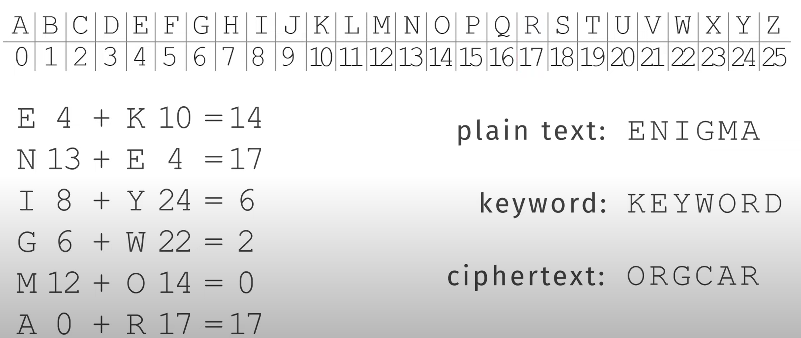
One-time Pad

Slide 18
Security of One-time Pad
OTP has unconditional security
OTP is information-theoretically secure (or provably secure)
Ciphertext C gives absolutely no additional information about the plaintext
Example: Eve intercepts Alice’s ciphertext : “EQNVZ”
Eve can find that key “XMCKL” would produce plaintext “HELLO”, but she would also find that key “TQURI” would produce plaintext “LATER”, equally plausible message

Slide 19
One-time Pad - Limitations
Practical limitations
Making large quantities of random keys
Problem of key distribution and protection, where for every message to be sent, a key of equal length is needed by both sender and receiver.
Use of one-time pads
British Special Operations Executive used OTPs in World War II
Hotline between Moscow and Washington DC (established after the Cuban missile crisis) used a commercial one-time tape system

Slide 20
Security Principles
Security by obscurity does not work!
The security of the system cannot rely on keeping the algorithm(s) secret.
Should assume that the adversary knows the algorithm; the only secret the adversary is assumed to not know is the key

Slide 21

Break Time…
Be back in 10 min

Slide 22
Modern Cryptography
Confidentiality:
Ensuring information is disclosed only to those authorized to know it.
Threats to consider:
Data in transit (packet sniffing/wiretap/surveillance, Man-in-the-middle, etc.)
Data at rest (DAR): (file grabbing from a compromised system, stolen laptop, etc.)

Slide 23
What Can We Enforce? PAIN
Privacy: Transactions cannot be viewed by an unauthorized party.
Authentication: Assurance that an entity’s identity claim is valid.
Integrity: Assurance that data has not been altered either intentionally or unintentionally.
Non-repudiation: Incontrovertible evidence of what occurred and who was involved.

Slide 24
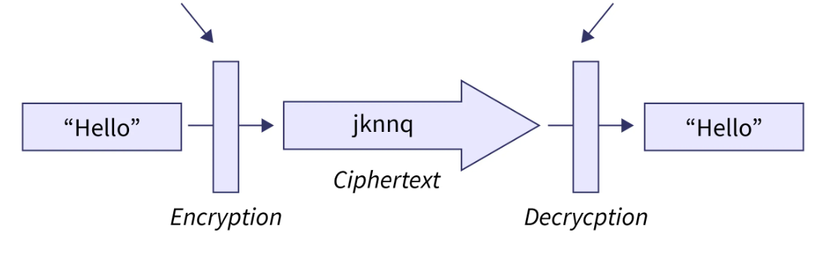
Cryptography Process
Encryption Key
Decryption Key
Decryption

Slide 25
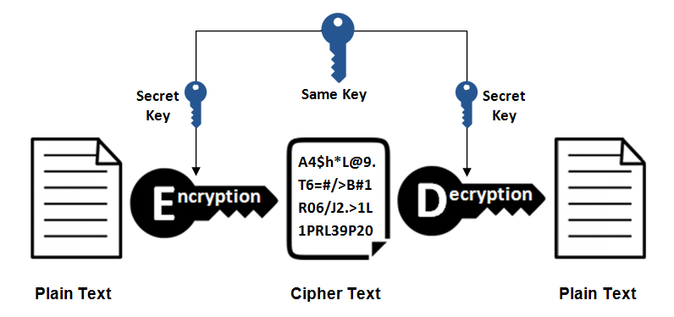
Symmetric Cryptography

Slide 26
Block Ciphers
Block ciphers process messages in blocks, each of which is then en/decrypted (like a substitution on very big characters, e.g., 64 bits)
Why Block Ciphers?
Another way to defeat frequency analysis
Make the unit of transformation larger (rather than encrypting letter by letter, encrypting block by block)

Slide 27
Modern Algorithms
Data Encryption Standard (DES)
Designed by IBM with modifications proposed by the National Security Agency
US national standard from 1977 to 2001
Advanced Encryption Standard (AES)
Originally developed by two Belgian cryptographers
Became standard for US government in 2001

Slide 28
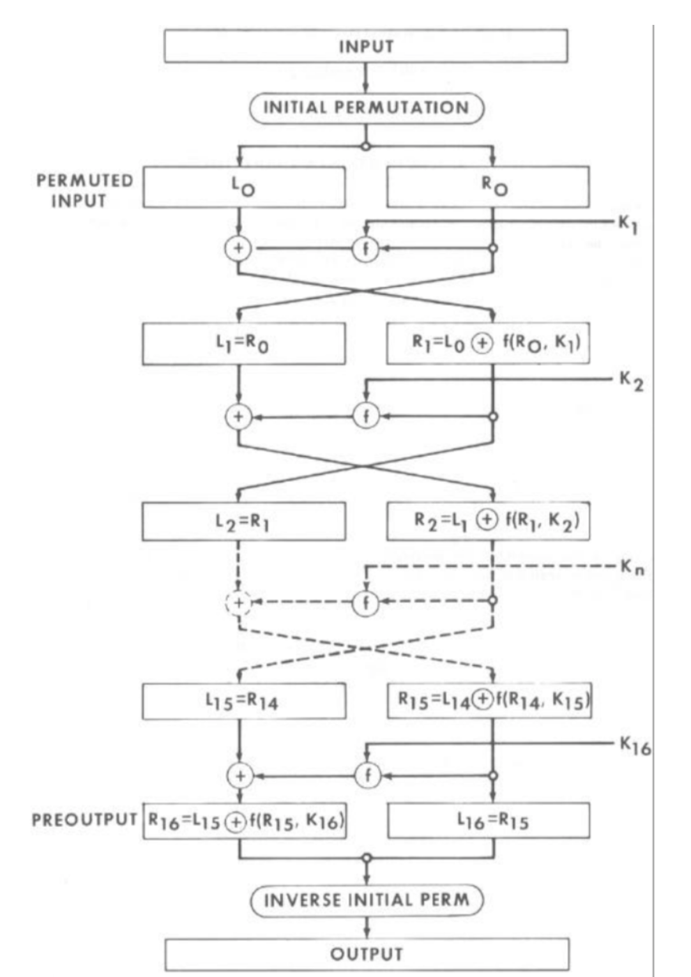
Data Encryption Standard (DES)
Symmetric-Key block cipher algorithm
Encrypts 64-bit blocks using a 56-bit key
16 iterations: replacing blocks of bits (Substitution), shuffling the bits (Permutation), mingling in bits from the key (Transformation)
Designed mostly for hardware implementations

Slide 29
Data Encryption Standard (DES)
Broken in 1999: 56-bit key is too small (vulnerable to brute-force attacks)
NIST withdrew DES as an encryption standard in 2005
Other versions:
Double DES: C = E(K2, E(K1, M)) just doubles the length of time to break this version
Triple DES: C = E(K3, E(K2, E(K1, M))) or E(K3, D(K2, E(K1, M))) Encryption strength up to 112-bit key

Slide 30
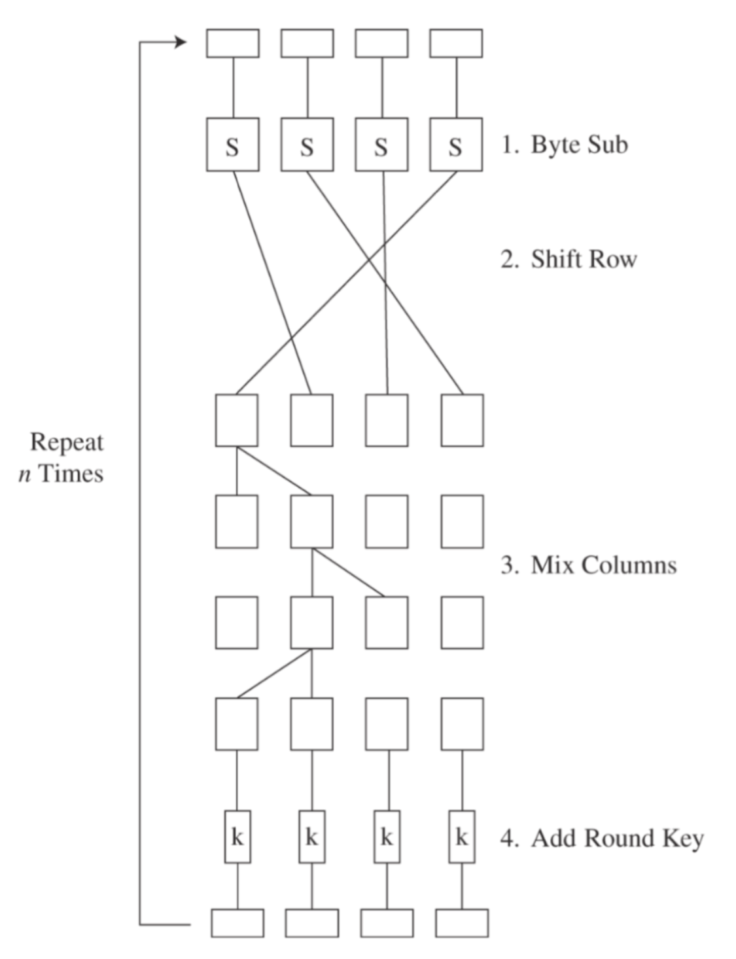
Advanced Encryption Standard (AES)
Goal: replace DES for both government and private-sector encryption.
Designed to be efficient in both hardware and software across a variety of platforms.
Block size: 128 bits
Variable key size: 128, 192, or 256 bits.
Variable number of rounds (10, 12, 14) depending on the Key size

Slide 31
Symmetric Key Summary
Both sides use the same key to encrypt & decrypt
Advantages
Fast – suitable for real-time and bulk encryption of high-speed communication systems
Disadvantages
Key Distribution
Key Management

Slide 32
Cryptography VS Steganography
Cryptography is about protecting the content of messages (their meaning).
Steganography is about concealing the existence of messages

Slide 33
Steganography - Basics
Steganography simply takes one piece of information and hides it within another:
Computer files (images, sounds recordings, etc.) contain unused or insignificant areas of data
Steganography takes advantage of these areas, replacing them with information.
The files can then be exchanged without anyone knowing what really lies inside of them

Slide 34
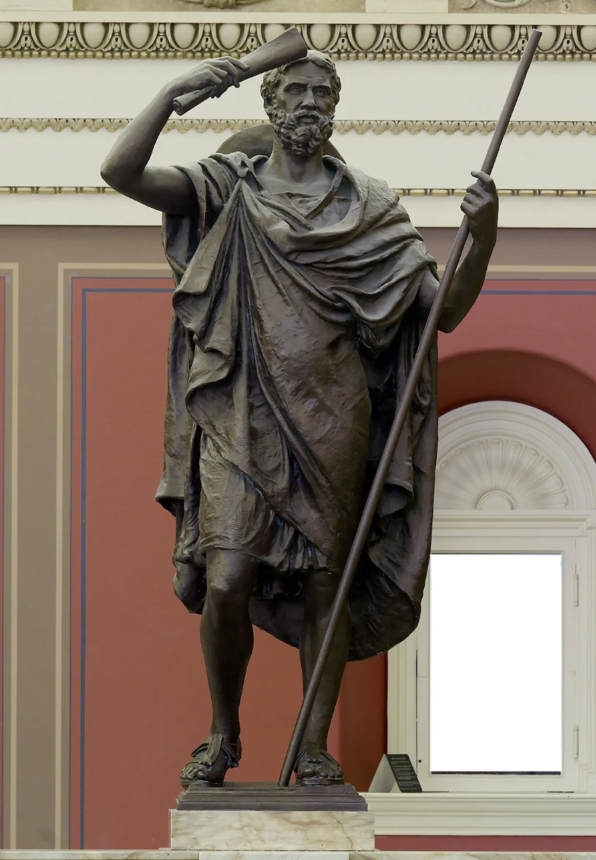
Steganography – Early Examples
In his history of the Persian Wars, Herodotus tells of a messenger who shaved his head and allowed a secret message to be tattooed on his scalp. He waited until his hair grew back. Then he journeyed to where the recipient awaited him and shaved his head again. The message was revealed. It was history’s first use of steganography.

Slide 35
Steganography – Other Examples
Roman Empire: Ancient Romans used to write between lines using invisible ink based on various natural substances.
World War II: A secret message was photographically reduced to the size of a period, and affixed as the dot for the letter 'i' or other punctuation on a paper containing a written message.

Slide 36
Computer Steganography
Computer Steganography is based on two principles.
Files containing digitized images or sound can be altered to a certain extend without loosing their functionality.
The other principle deals with the human inability to distinguish minor changes in image color or sound quality, which is especially easy to make use of in objects that contain redundant information. The value of the least significant bit of the pixel color won’t result in any perceivable change of that color.

Slide 37
Steganography - Process
The data to be concealed is compressed and hidden within another file.
The first step is to find a file which will be used to hide the message (also called a carrier or a container.)
The next step is to embed the message one wants to hide within the carrier using a steganographic technique.
Most used embedding technique: replace the least significant bit of each byte in the [carrier] with a single bit for the hidden message.

Slide 38
Steganalysis
The art of discovering and rendering useless such covert messages.
Steganalysis involves analysis of the carrier file
Simpler steganographic techniques produce some discernible change in the file size, statistics or both.
These changes can manifest themselves in color variations, loss of resolution and other distortions that are visible to the human eye.
This form of detection requires that you know what the original carrier image or file should look like.

Slide 39

Do you have any questions?

